Slide 2
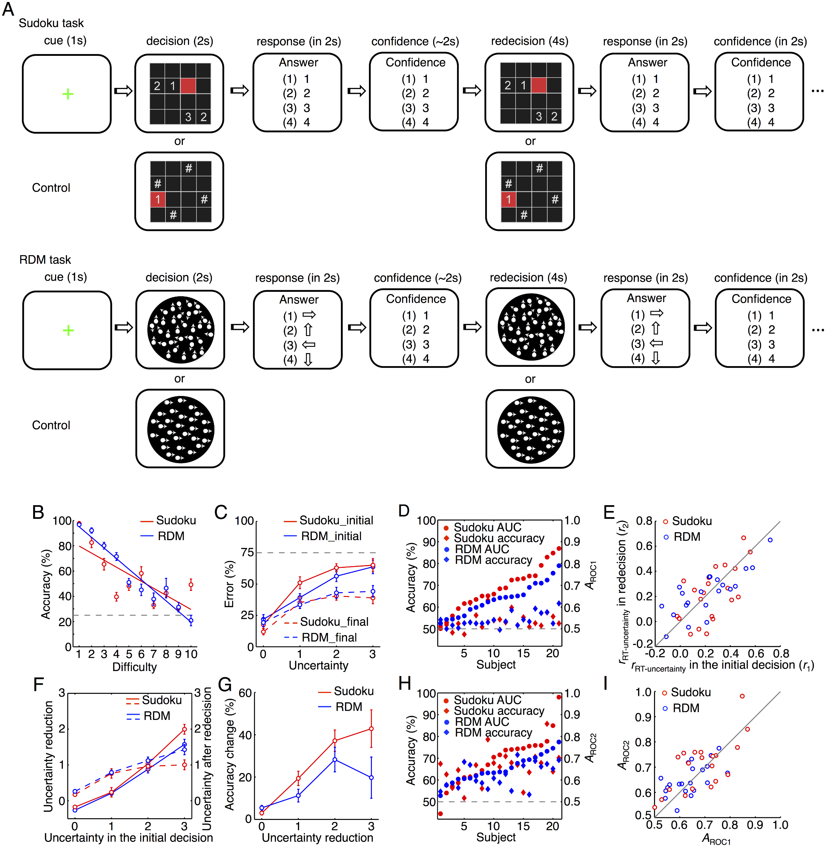
Notes:
Qiu et al., PLOS Biology, 2018

Slide 3
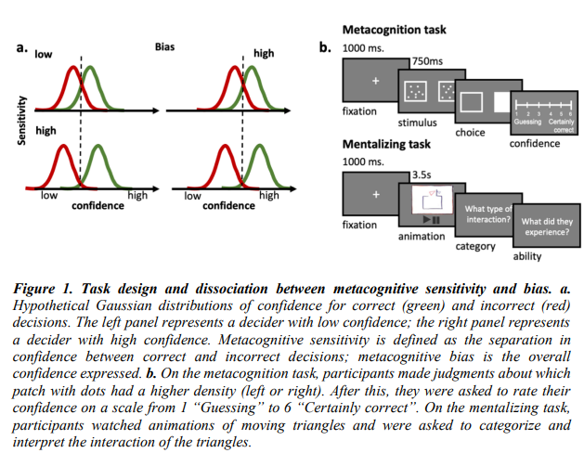
Notes:
Van der Plas,…, Fleming 2021 in PsychArxiv

Slide 4
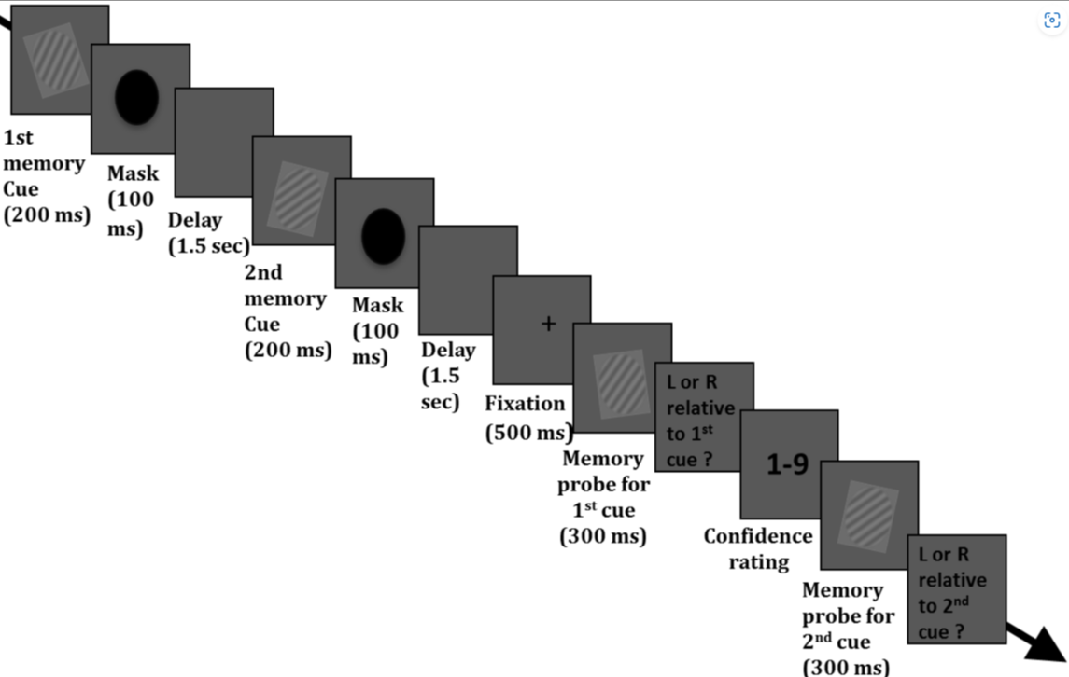
Notes:
Bonas & Silvanto, 2014, PLoS one

Slide 5
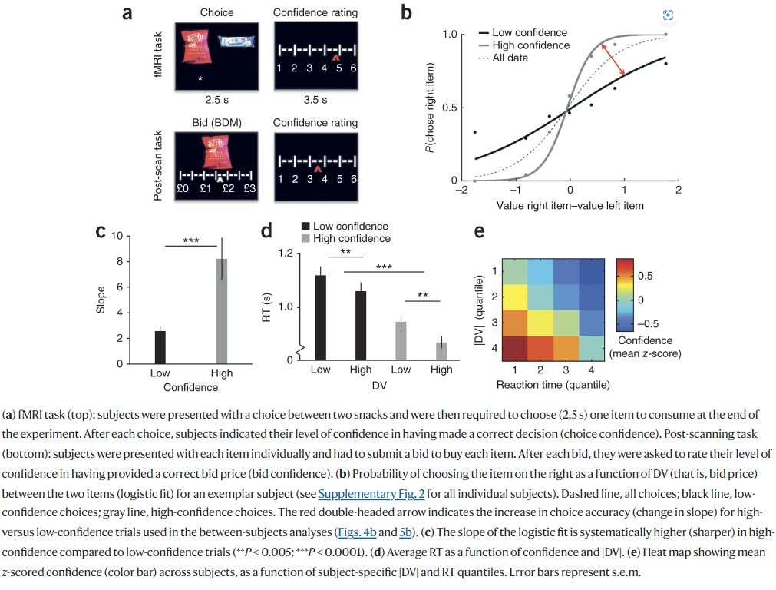
Notes:
De Martino, Fleming et al., Nature Neurosci, 2013

